Slide 1
XGBoostAlgorithm

Slide 2
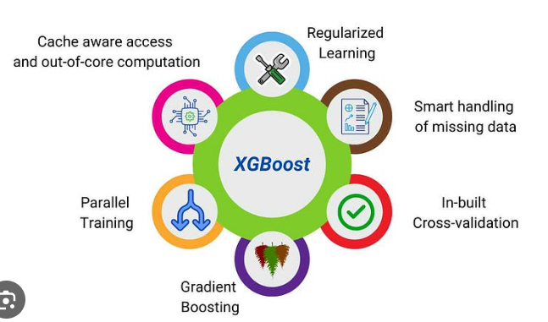
XGBoostRegressor

Slide 3
What is XGBoost regressor ?
It is an optimized implementation of Gradient boosting and is a type of ensemble learning method that combines multiple weak models to form a stronger model.
XGBoost uses decision trees as its base learners and combines them sequentially to improve the model’s performance. Each new tree is trained to correct the errors made by the previous tree and this process is called boosting.
It has built-in parallel processing to train models on large datasets quickly. XGBoost also supports customizations allowing users to adjust model parameters to optimize performance based on the specific problem.
It builds decision trees sequentially with each tree attempting to correct the mistakes made by the previous one.

Slide 4
Code:
from xgboost import XGBRegressor
regressor = XGBRegressor()
regressor.fit(x_train, y_train)

